Slide 1
Computer Networks and the Internet
Computer Networking: A Top Down Approach
Chapter 1

Slide 2
CS-3001 Computer Networks
Instructor: Salma Kulsoom
Classes: Monday, Wednesday
Communication and announcements: Everything on Slate
Counselling hours: Monday 2:30 PM to 4:00 PM
Text book: Computer Networking by James F. Kurose
Grading Policy;
Assignments: 10%
Quies: 10%
Mids: 30%
Final:50%

Slide 3
Objectives
Get into basics of networking
Types of connections
Circuit Switching
Packet switching (Datagram and Virtual circuit)

Slide 4
Content
What is internet?
Internet nuts and bolts (Components of internet)
Edges and core of internet
Network protocols
Connection oriented and connectionless services
Point to point and multipoint connection
Circuit switching
Frequency division multiplexing
Time division multiplexing
Packet switching
Datagram
Virtual circuit switching
Practice questions

Slide 5
Computer Network
Computer Network: Two or more devices that are connected with one another for the purpose of communicating data electronically.
00
A cohesive architecture that allows a variety of equipment to transfer information in a near-seamless fashion.
00
Internet: Global computer network where networks from around the world are connected through standard protocols.

Slide 6
Nuts and Bolts View of Internet
Core components that formulates an internet.
Software: Network applications, Protocols, Operating System
Hardware:
End Systems -> Sender, Receiver, Host, Node, Client, Servers
Host
Communication link -> Chanel, media, medium, connection,
Switch
Hub
Router
Modem
Base station
Satellite Links
Repeaters

Slide 7
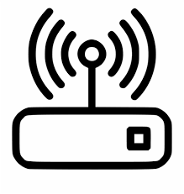

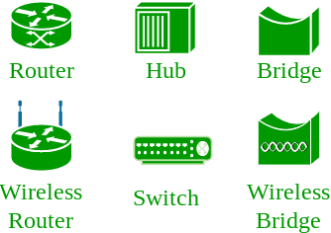

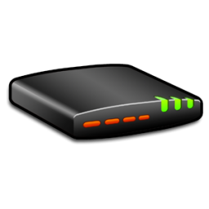
Nuts and Bolts of Internet
Base Station
ISP
Modem
Satellite Link

Slide 8
Edges and Core of Network
Edges: End devices, clients, servers
00
Core: Router, Gateways, Bridges, Switches

Slide 9
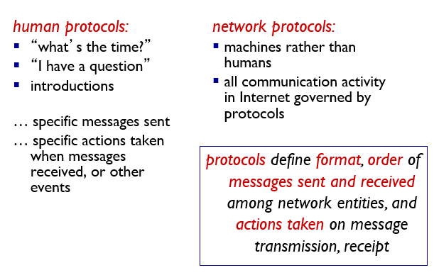
Internet Protocols

Slide 10
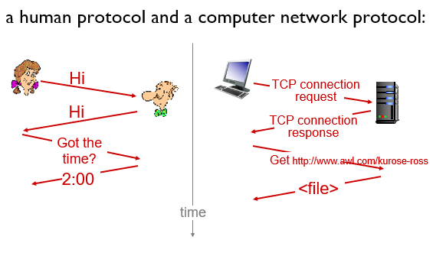
Internet Protocol

Slide 11
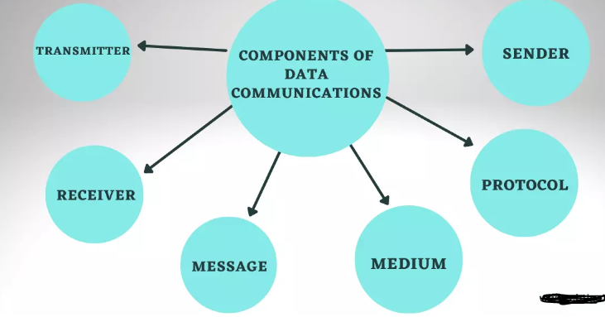
Components of Data Communication

Slide 12
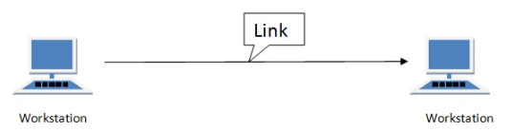
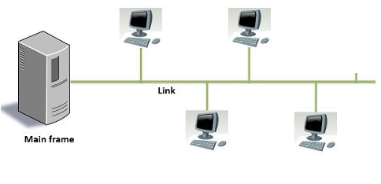
Point to Point Vs Multipoint

Slide 13
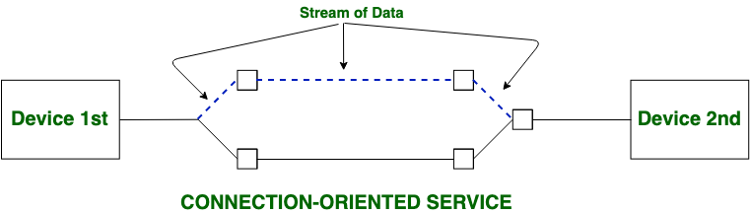
Connection Oriented Services
Works on basis of Hand-shaking protocol

Slide 14
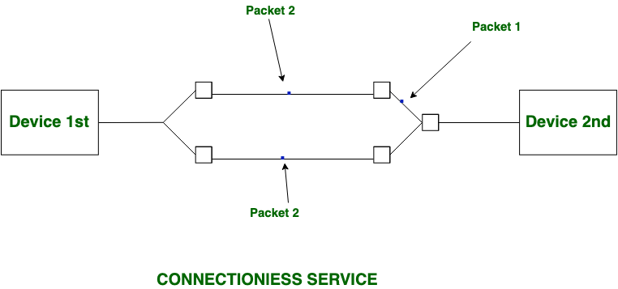
Connectionless Services

Slide 15
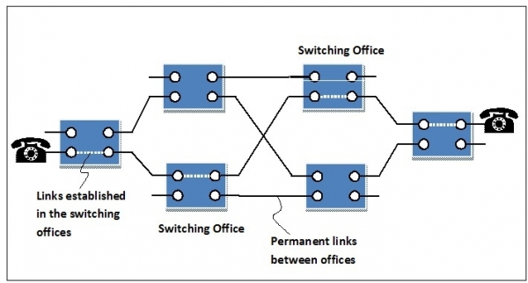
Circuit Switching
Setup time= Time required for establishing setup
Transmission time= Number of bits in message/ Bandwidth
Propagation delay= Distance/ Speed
Teardown time= Time required for releasing resources
Total Transmission Time= Setup time + Transmission time + Propagation delay + Teardown Time
Total transmission time is also called total delay.

Slide 16
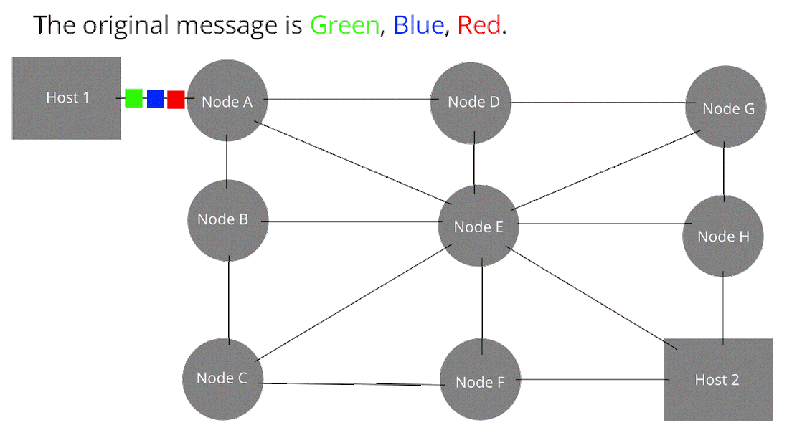
Packet Switching
n= number of routers
Transmission time= Number of bits in message/ Bandwidth
Propagation delay= Distance/ Speed
Teardown time= Time required for releasing resources
Total transmission delay also includes queuing delay and processing delay at each hop (hop is a point or a router from where packets are transmitted to next node.) If they are not mentioned, then ignore them.
Total Transmission Time= n(Transmission time) + Propagation delay

Slide 17
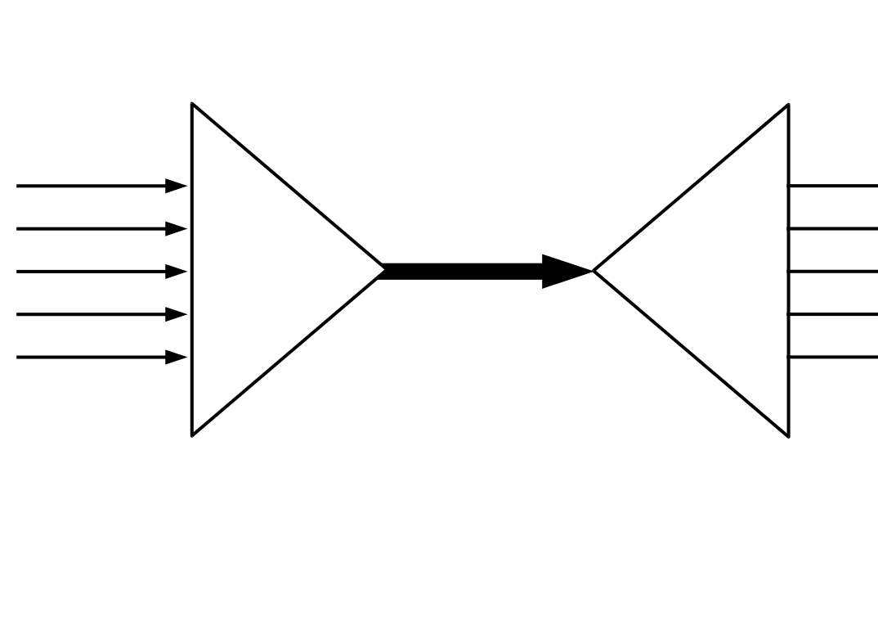
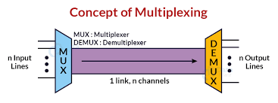
Multiplexing in Circuit Switching
Multiplexing: Combining multiple analog or digital signals into one composite signal that is transported over a communication medium.
Demultiplexing: Converting a single signal with multiple streams into separate signals in order to transform it back into their original form.

Slide 18
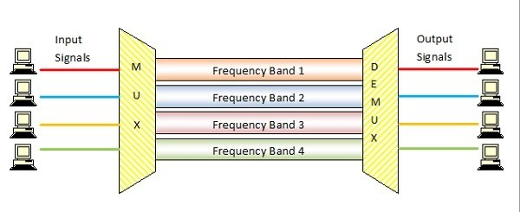
Frequency Division Multiplexing
Total Transmission Time= Setup time + Transmission time + Propagation delay + Teardown Time
Since bandwidth is divided among slots:
Bandwidth per slot= total bandwidth/ number of slots
Notes:
Frequency division multiplexing (FDM) is a multiplexing technique that divides the available bandwidth into multiple sub-bands each of which can carry a signal. Therefore, FDM enables concurrent transmissions over a shared communication medium. As another common use, FDM enables the system to send a huge amount of data through several segments transmitted over independent frequency sub-bands.

Slide 19
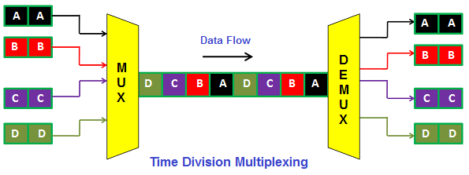
Time Division Multiplexing
Total Transmission Time= Setup time + Transmission time + Propagation delay + Teardown Time
Since bandwidth is divided among slots:
Bandwidth per slot= Total bandwidth/ (number of frames * bits in each frame)
Notes:
Time division multiplexing (TDM) is a communications process that transmits two or more streaming digital signals over a common channel. In TDM, incoming signals are divided into equal fixed-length time slots. After multiplexing, these signals are transmitted over a shared medium

Slide 20
Datagram Packet
Pure packet switching
No reservation of packets
No order of packets
Packets randomly choose any path
Headers associated with each packet
Frequent packet loss
More efficient

Slide 21
Virtual Packet Switching
Connection less, do not work on hand-shaking principle
Less efficient
More wastage of resources
Global header only with first packet
Less overhead
Less dealy

Slide 22
Practice Exercises
Mentioned in the self study material

Slide 23
To be continued..

